Slide 1
DES algorithm Task 3
Aniket Dere
Matriculation Number: 60334138

Slide 2
Introduction
The Data Encryption Standard (DES) is a symmetric-key algorithm for encrypting electronic data. Developed in the early 1970s by IBM in cooperation with the United States government, DES was one of the first widely adopted encryption standards. It has since been superseded by more advanced encryption techniques, but its design principles continue to influence cryptographic research.

Slide 3
Technical Overview
DES is a block cipher, meaning it encrypts data in fixed-size blocks (64 bits in DES’s case). It uses a 56-bit key, although each key is represented by 64 bits (8 bits are used for parity checking).
Key Features
Block Size: 64 bits
Key Length: 56 bits (plus 8 parity bits)
Structure: Feistel Network
Number of Rounds: 16
Key Schedule: Generates 16 subkeys for use in each round.

Slide 4
Operational Stages
a. Key Schedule
The 64-bit key is reduced to 56 bits by removing parity bits.
This key is then permutated and split into two 28-bit halves.
Each half is subjected to left shifts and permutated by permutation choice 2 (PC2) to generate 16 round keys.
b. Initial Permutation (IP)
The 64-bit plaintext block undergoes an initial permutation that rearranges the bits according to a predefined table.
c. Rounds
Each of the 16 rounds consists of:
Expansion: The right 32-bit half of the data expands to 48 bits using an expansion table.
Mixing: The expanded data is mixed with a round key using XOR.
Substitution: The mixed data is then compressed from 48 to 32 bits using 8 substitution boxes (S-boxes), each box processing 6 bits of input and producing 4 bits of output.
Permutation: The output from the S-boxes is permutated.
Merging: This output is then XORed with the left half of the data.
The left and right halves are swapped for the next round.
d. Final Permutation (FP)
After 16 rounds, the halves are not swapped.
A final permutation, which is the inverse of the initial permutation, is applied to the combined block.

Slide 5
Key Components
Constants:
IP (Initial Permutation Table): Defines the initial permutation of the plaintext.
FP (Final Permutation Table): Used for the final permutation, effectively the inverse of IP.
PC1 and PC2 (Permutation Choice Tables): Used in key schedule for generating subkeys.
E (Expansion Table): Expands the 32-bit half-block to 48 bits in each round.
SBOX (Substitution Boxes): 8 substitution boxes used for the substitution step in each round.
P (Permutation Function): Permutation used after the substitution step.
SHIFTS: Specifies the number of left shifts for each round in key generation.

Slide 6
Key Schedule Generation (generateSubKeys):
Applies PC1 to the 64-bit key (excluding parity bits) and splits it into two 28-bit halves.
Each half is left-shifted and combined, followed by PC2 to generate the 48-bit subkeys for each of the 16 rounds.
Feistel Function (feistel):
Expands the right half of the data, XORs with a subkey, applies S-boxes, and then a final permutation (P-table).
DES Round (desRound):
Each round applies the Feistel function on the right half and then XORs the result with the left half. The halves are then swapped.
Encryption and Decryption:
Encryption (encrypt): Applies initial permutation, 16 rounds of DES, swaps the halves, and then applies the final permutation.
Decryption (decrypt): Similar to encryption but uses the subkeys in reverse order.

Slide 7
Utility Methods:
permute: Applies the various permutation tables.
leftShift: Performs left circular shifts for key generation.
combineHalves: Combines two halves of the key.
fromByteArray and toByteArray: Convert between byte arrays and BitSet.
padPlainText and removePadding: Pad the plaintext to a multiple of 8 bytes and remove padding after decryption.

Slide 8
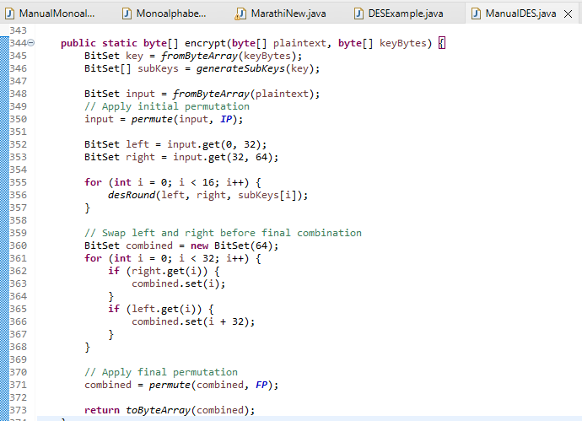
Implementation details. Encrypt() method

Slide 9
Steps in the encrypt Function:
Key Preparation:
The key is converted from a byte array to a BitSet object for easier manipulation.
The generateSubKeys method is called to create 16 subkeys from the main key, which will be used in each of the 16 rounds of the DES algorithm.
Initial Permutation:
The plaintext is converted to a BitSet and then subjected to an initial permutation (IP). This step rearranges the bits of the plaintext according to the IP table, providing an initial scrambling of the data.
16 Rounds of Processing:
The BitSet representing the permuted plaintext is split into two halves: left and right.
For each of the 16 rounds, the desRound function is called with the current left and right halves and the corresponding subkey.
In each round, the Feistel function is applied to the right half and the result is XORed with the left half. Then, the halves are swapped.
Final Combination and Swap:
After 16 rounds, the final left and right halves are combined into a single BitSet, but with a twist: they are swapped. The right half becomes the first 32 bits, and the left half becomes the last 32 bits of the combined BitSet.
Final Permutation:
The final combined BitSet is then subjected to a final permutation using the FP table, which is the inverse of the initial permutation. This step rearranges the bits back to their original positions.
Output:
Finally, the BitSet is converted back into a byte array using the toByteArray method and returned. This byte array represents the encrypted data.

Slide 10
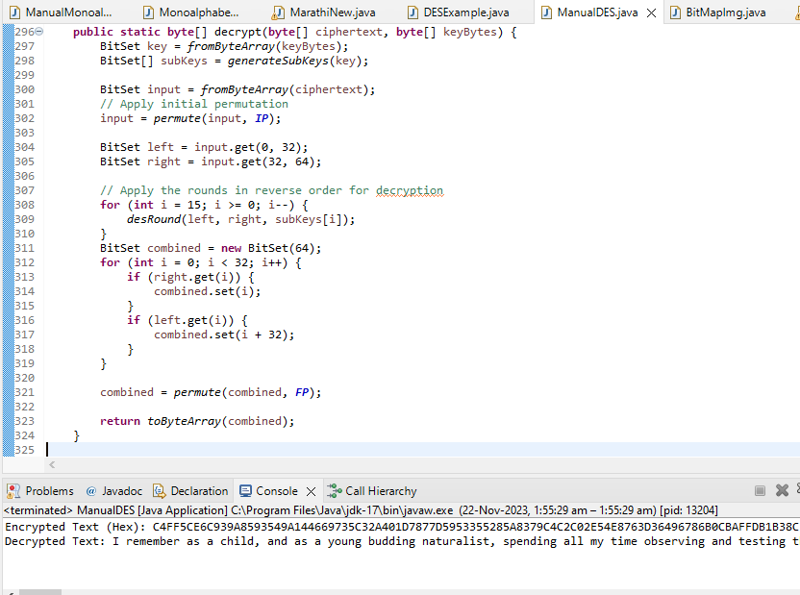
Implementation details. decrypt() method

Slide 11
Key Preparation:
Similar to the encryption process, the decryption key is converted from a byte array to a BitSet for manipulation.
The generateSubKeys method is used to create 16 subkeys from the main key. These subkeys will be applied in reverse order compared to encryption.
Initial Permutation:
The ciphertext is first converted to a BitSet and then subjected to an initial permutation (IP). This rearranges the bits of the ciphertext according to the IP table.
16 Rounds of Processing:
The permuted BitSet representing the ciphertext is divided into two halves: left and right.
For each of the 16 rounds, the desRound function is called, but in reverse order of the rounds during encryption (starting from the last subkey and moving to the first).
Each round involves applying the Feistel function to the right half, XORing the result with the left half, and then swapping the halves.

Slide 12
Final Combination and Swap:
After all the rounds, the final left and right halves are combined into a single BitSet. The halves are swapped, with the right half becoming the first 32 bits, and the left half the last 32 bits of the combined BitSet.
Final Permutation:
The combined BitSet is then subjected to a final permutation using the FP table. This final permutation is the inverse of the initial permutation, effectively undoing the initial scrambling of the bits.
Output:
The resulting BitSet is converted back into a byte array using the toByteArray method. This byte array represents the decrypted data, which should match the original plaintext before encryption.

Slide 13
